Slide 1
Mario Kart micro:bit.
Activity #1
Mario Kart Unplugged.
Draw the animations you would like to the Mario Kart drivers to see. Label the sequence of your animation.
Repeat 5 times
Repeat 3 times
Repeat 2 times

Slide 2
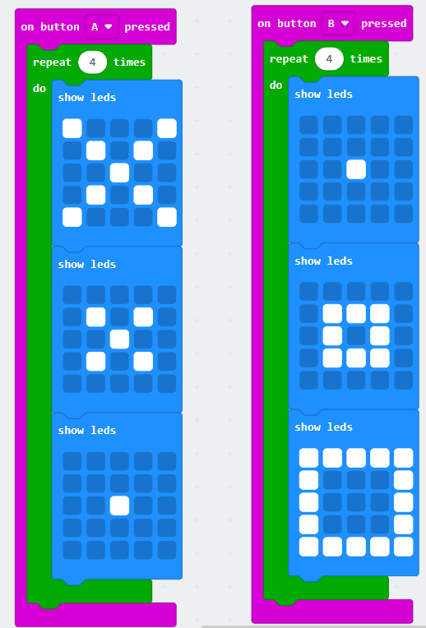
Mario Kart Animations.
Activity #2
Micro:bit Coding.
Example Solution Code:
Task 1: Use the A & B input buttons to create animations on your micro:bit
Task 2: Use the repeat blocks to repeat an animation on the micro:bit
Challenges:
Use the 'Shake' and on pin press input blocks to show animations
Use the sound blocks (if micro:bit v2) to create driver notifications

Slide 3
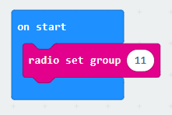
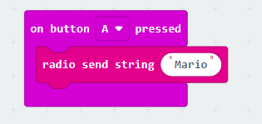
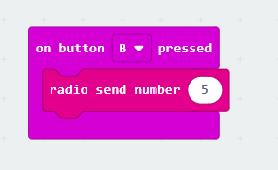
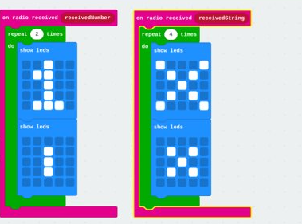
Mario Kart Animations.
Activity #3
Micro:bit Radio Coding.
Example Code:
Task: On two micro:bits, use the micro:bit radio blocks to broadcast from one micro:bit and show animations on the other.
Challenge: Use the radio blocks to broadcast messages (and sounds if v2) between several micro:bits

